Slide 1
Smart Stock Inventory Management System
Project Progress Report: 3
Presented by: Rudrakshi Jaiswal

Slide 2
Objective
Design
Design a secure backend system
Separate
Separate access for Manager and Staff
Ensure
Ensure data safety and role control
Maintain
Maintain clean and structured database records

Slide 3
User Roles Design
Roles Implemented:
Manager
  Full access to system data
  Can add, update, and delete records
Staff
  Read-only access
  Can only view data
  Reason:
Prevent unauthorized data changes
Follow real-world company hierarchy

Slide 4
Authentication & Role Control
Authentication:
  Login-based authentication
  JWT used to identify users securely
Role Handling:
  User role stored in database
  Role checked on every request
  Access granted based on role type

Slide 5
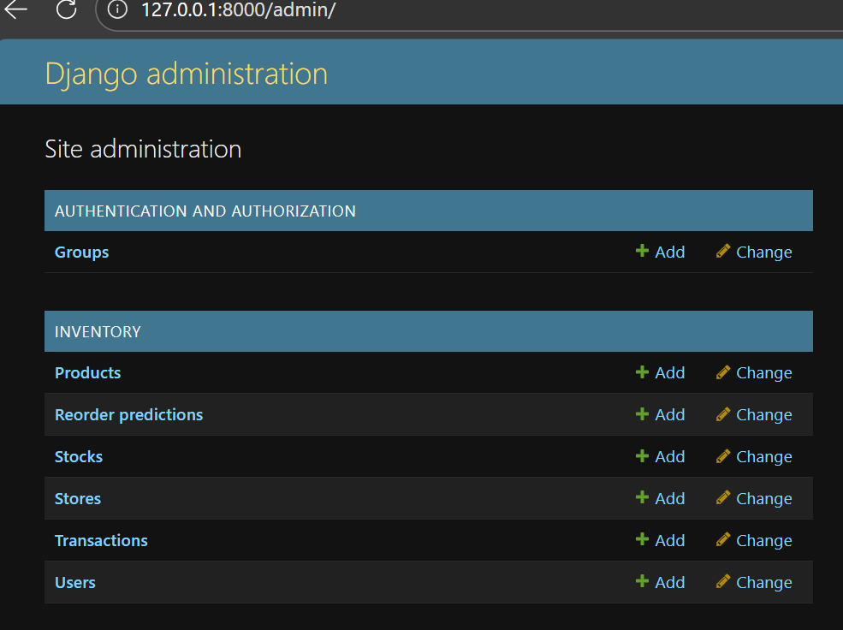
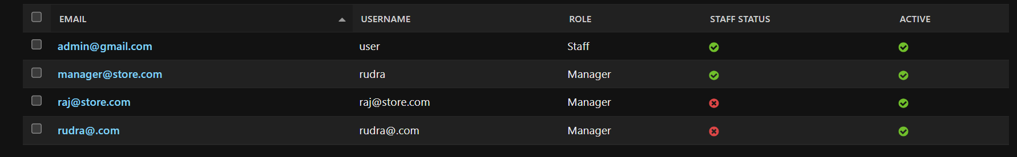
Database Structure
Main Tables:
User
Product
Store
Stock
Transaction

Slide 6
Work Completed So Far
User role implementation (Manager / Staff)
Authentication system completed
Database models created
Role-based access enforced
Basic inventory data flow working

Slide 7
Next Steps
Add frontend interface
Improve data visualization
Testing and optimization

